Slide 1
5
Control Statements: Part 2
Slides edited by Dr. Selim Aksoy

Slide 2
Not everything that can be counted counts, and not every thing that counts can be counted.
  Albert Einstein
Who can control his fate?
  William Shakespeare
The used key is always bright.
  Benjamin Franklin
Intelligence… is the faculty of making artificial objects, especially tools to make tools.
  Henri Bergson
Every advantage in the past is judged in the light of the final issue.
  Demosthenes

Slide 3
OBJECTIVES
In this chapter you will learn:
The essentials of counter-controlled repetition.
To use the for and do…while repetition statements to execute statements in a program repeatedly.
To understand multiple selection using the switch selection statement.
To use the break and continue program control statements to alter the flow of control.
To use the logical operators to form complex conditional expressions in control statements.
To avoid the consequences of confusing the equality and assignment operators.

Slide 4
5.1 Introduction
5.2 Essentials of Counter-Controlled Repetition
5.3 for Repetition Statement
5.4 Examples Using the for Statement
5.5 do…while Repetition Statement
5.6 switch Multiple-Selection Statement
5.7 break and continue Statements
5.8 Logical Operators
5.9 Confusing Equality (==) and Assignment (=) Operators
5.10 Structured Programming Summary
5.11 (Optional) Software Engineering Case Study: Identifying Objects’ States and Activities in the ATM System
5.12 Wrap-Up

Slide 5
5.1 Introduction
Continue structured programming discussion
  Introduce C++’s remaining control structures
    for, do…while, switch

Slide 6
5.2 Essentials of Counter-Controlled Repetition
Counter-controlled repetition requires:
  Name of a control variable (loop counter)
  Initial value of the control variable
  Loop-continuation condition that tests for the final value of the control variable
  Increment/decrement of control variable at each iteration

Slide 7
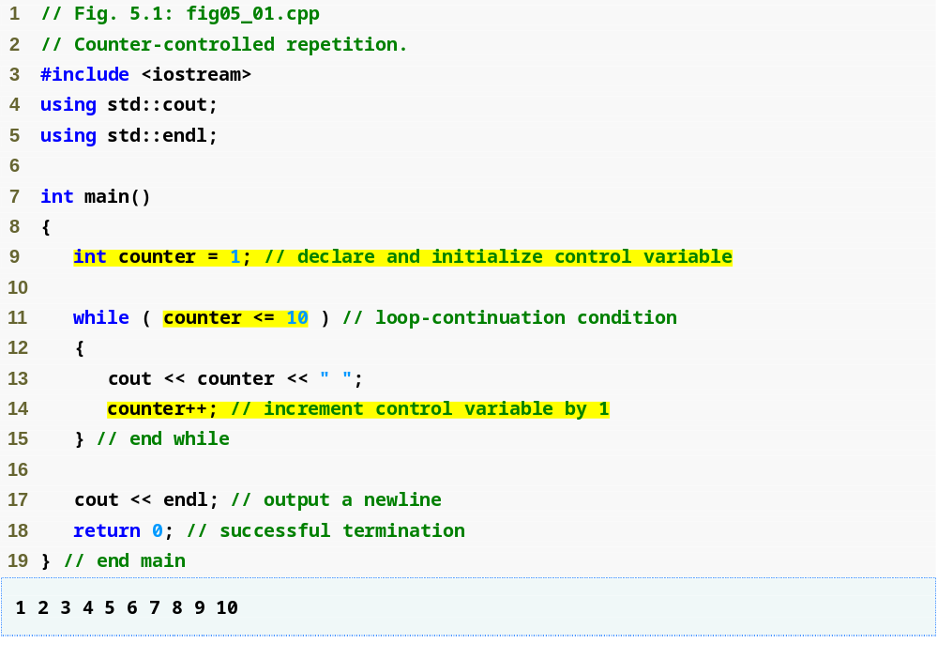
Outline
Control-variable name is counter with variable initial value 1
fig05_01.cpp
(1 of 1)
Condition tests for counter’s final value
Increment the value in counter

Slide 8
5.3 for Repetition Statement
for repetition statement
  Specifies counter-controlled repetition details in a single line of code

Slide 9
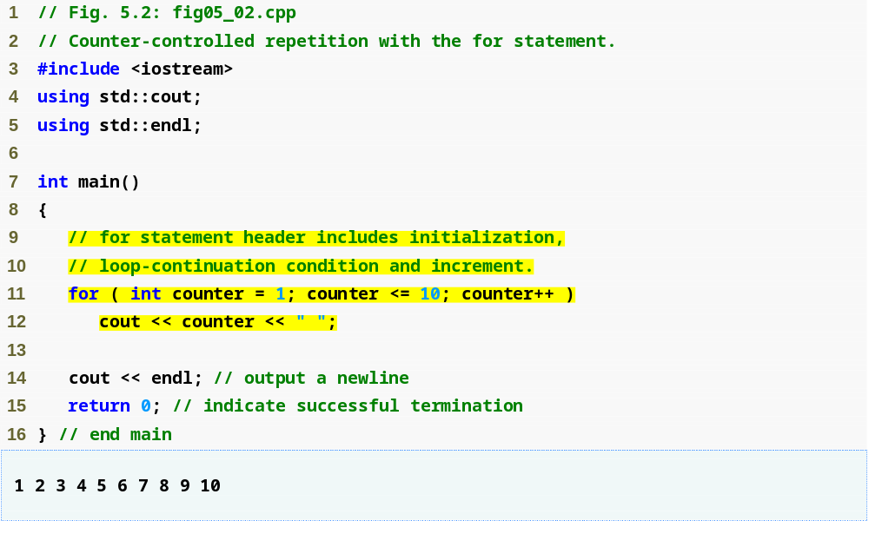
Outline
fig05_02.cpp
(1 of 1)
Increment for counter
Condition tests for counter’s final value
Control-variable name is counter with initial value 1

Slide 10
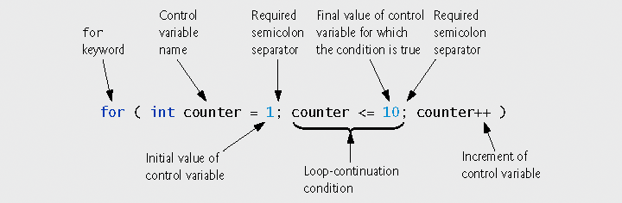
Fig. 5.3 | for statement header components.

Slide 11
5.3 for Repetition Statement (Cont.)
General form of the for statement
  for ( initialization; loopContinuationCondition; increment )
  statement;
Can usually be rewritten as:
  initialization;
  while ( loopContinuationCondition )
{
statement;
increment;
}
If the control variable is declared in the initialization expression
  It will be unknown outside the for statement

Slide 12
5.3 for Repetition Statement (Cont.)
The initialization and increment expressions can be comma-separated lists of expressions
  These commas are comma operators
    Comma operator has the lowest precedence of all operators
  Expressions are evaluated from left to right
  Value and type of entire list are value and type of the rightmost expressions

Slide 13
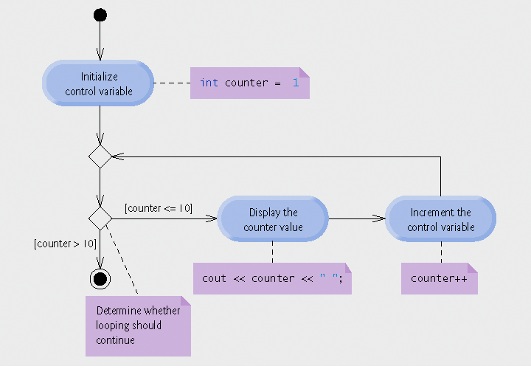
Fig. 5.4 | UML activity diagram for the for statement in Fig. 5.2.

Slide 14
5.4 Examples Using the for Statement
for statement examples
  Vary control variable from 1 to 100 in increments of 1
    for ( int i = 1; i <= 100; i++ )
  Vary control variable from 100 to 1 in increments of -1
    for ( int i = 100; i >= 1; i-- )
  Vary control variable from 7 to 77 in steps of 7
    for ( int i = 7; i <= 77; i += 7 )
  Vary control variable from 20 to 2 in steps of -2
    for ( int i = 20; i >= 2; i -= 2 )
  Vary control variable over the sequence: 2, 5, 8, 11, 14, 17, 20
    for ( int i = 2; i <= 20; i += 3 )
  Vary control variable over the sequence: 99, 88, 77, 66, 55, 44, 33, 22, 11, 0
    for ( int i = 99; i >= 0; i -= 11 )

Slide 15
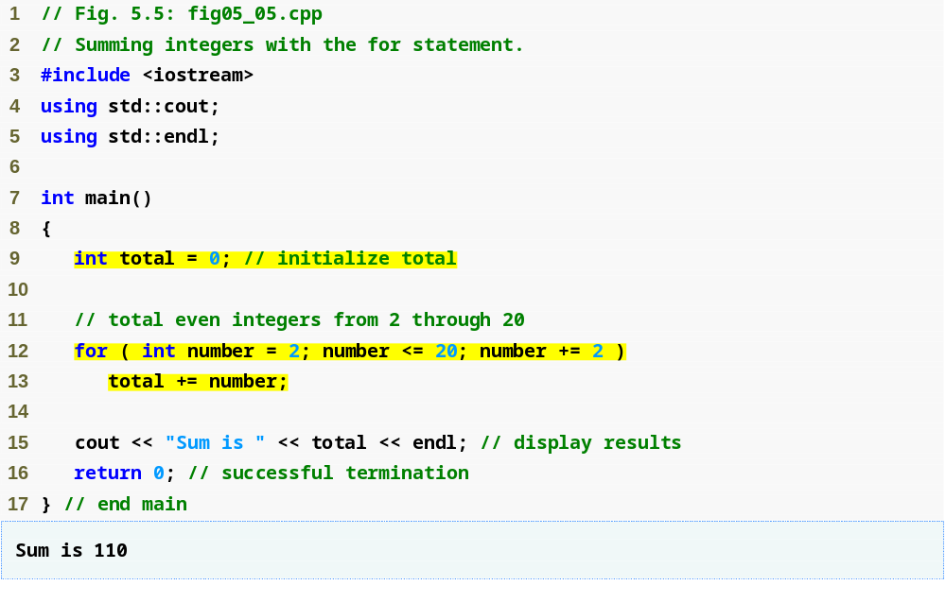
Outline
fig05_05.cpp
(1 of 1)
Vary number from 2 to 20 in steps of 2
Add the current value of number to total

Slide 16
5.4 Examples Using the for Statement (Cont.)
Using a comma-separated list of expressions
  Lines 12-13 of Fig. 5.5 can be rewritten as
  for ( int number = 2; // initialization
  number <= 20; // loop continuation condition
  total += number, number += 2 ) // total and
  // increment
  ; // empty statement

Slide 17
5.4 Examples Using the for Statement (Cont.)
Standard library function std::pow
  Calculates an exponent
  Example
    pow( x, y )
      Calculates the value of x raised to the y^{th} power
  Requires header file <cmath>

Slide 18
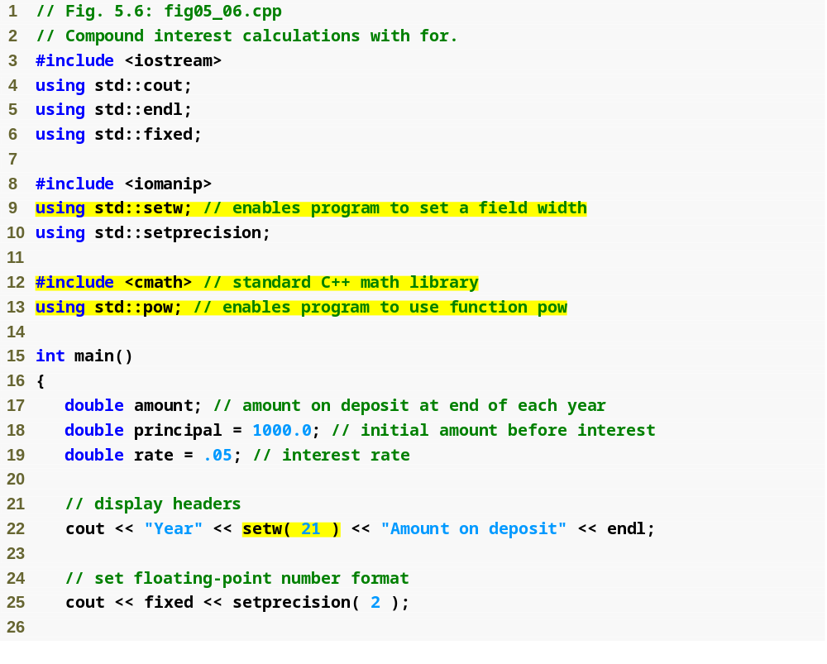
Outline
setw stream manipulator will set a field width
fig05_06.cpp
(1 of 2)
standard library function pow (in header file <cmath>)
C++ treats floating-point values as type double
Specify that the next value output should appear in a field width of 21

Slide 19
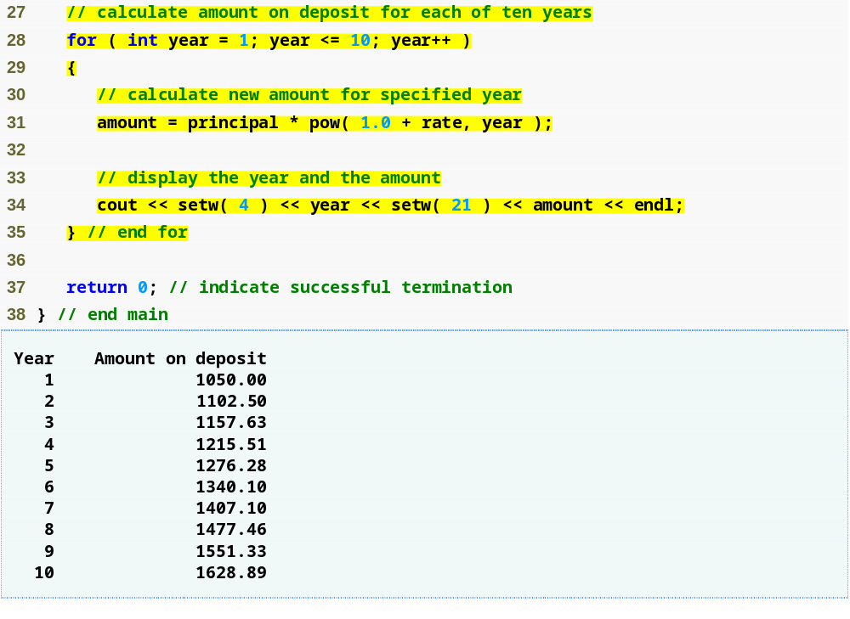
Outline
Calculate amount within for statement
fig05_06.cpp
(2 of 2)
Use the setw stream manipulator to set field width

Slide 20
5.4 Examples Using the for Statement (Cont.)
Formatting numeric output
  Stream manipulator setw
    Sets field width
      Right justified by default
        Stream manipulator left to left-justify
        Stream manipulator right to right-justify
    Applies only to the next output value
  Stream manipulators fixed and setprecision
    Sticky settings
      Remain in effect until they are changed

Slide 21
5.5 do…while Repetition Statement
do…while statement
  Similar to while statement
  Tests loop-continuation after performing body of loop
    Loop body always executes at least once

Slide 22
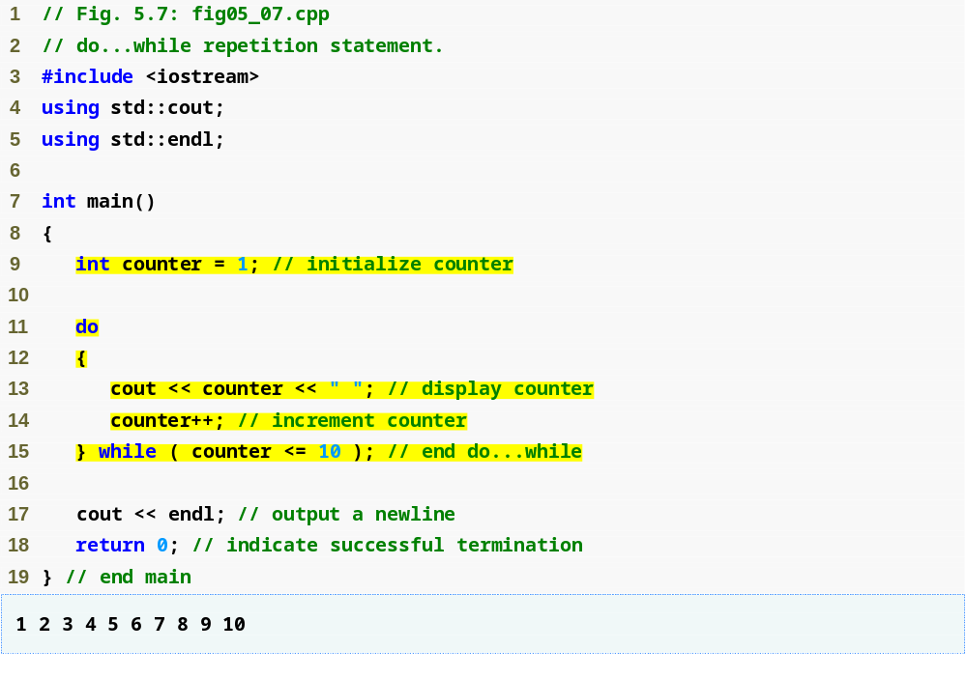
Outline
Declare and initialize control variable counter
fig05_07.cpp
(1 of 1)
do…while loop displays counter’s value before testing for counter’s final value

Slide 23
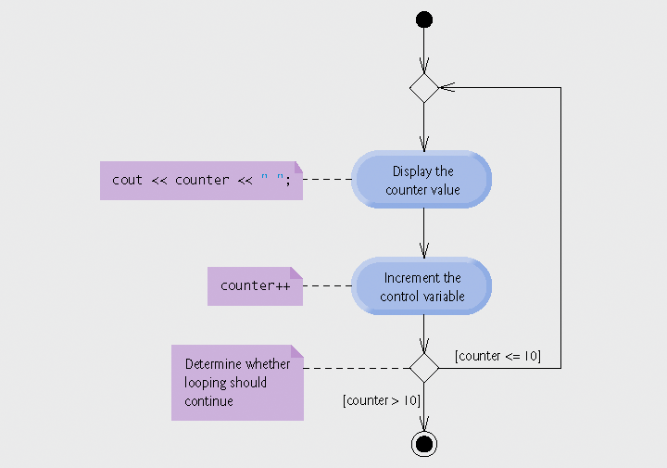
Fig. 5.8 | UML activity diagram for the do...while repetition statement of Fig. 5.7.

Slide 24
5.6 switch Multiple-Selection Statement
switch statement
  Used for multiple selections
  Tests a variable or expression
    Compared against constant integral expressions to decide on action to take
      Any combination of character constants and integer constants that evaluates to a constant integer value

Slide 25
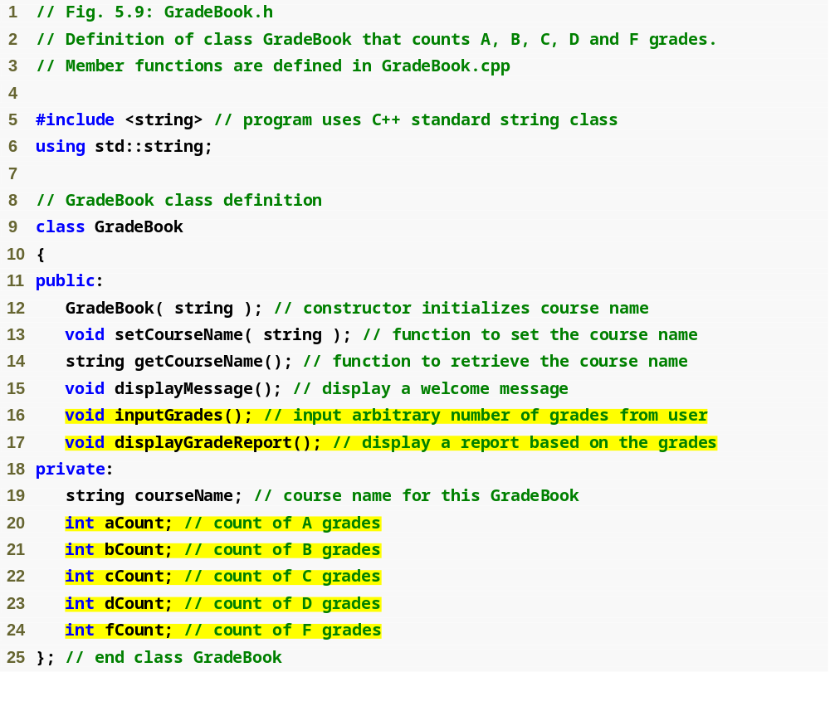
Outline
fig05_09.cpp
(1 of 1)
Counter variable for each grade category

Slide 26
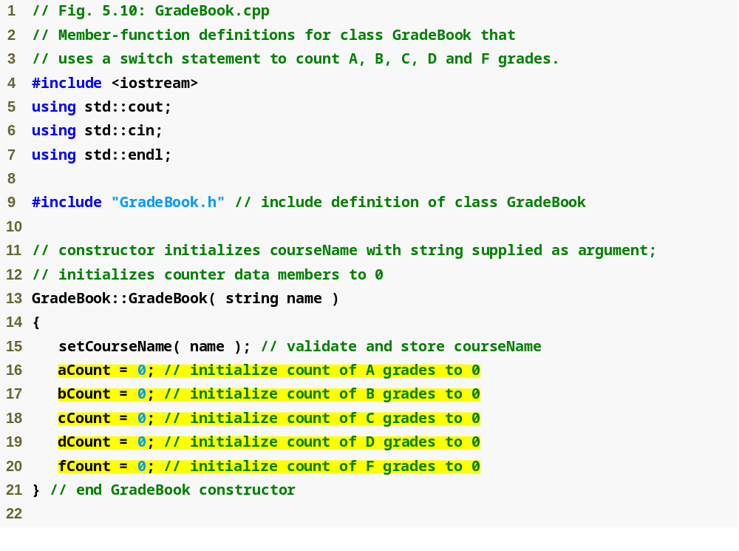
Outline
fig05_10.cpp
(1 of 5)
Initialize each counter variable to 0

Slide 27
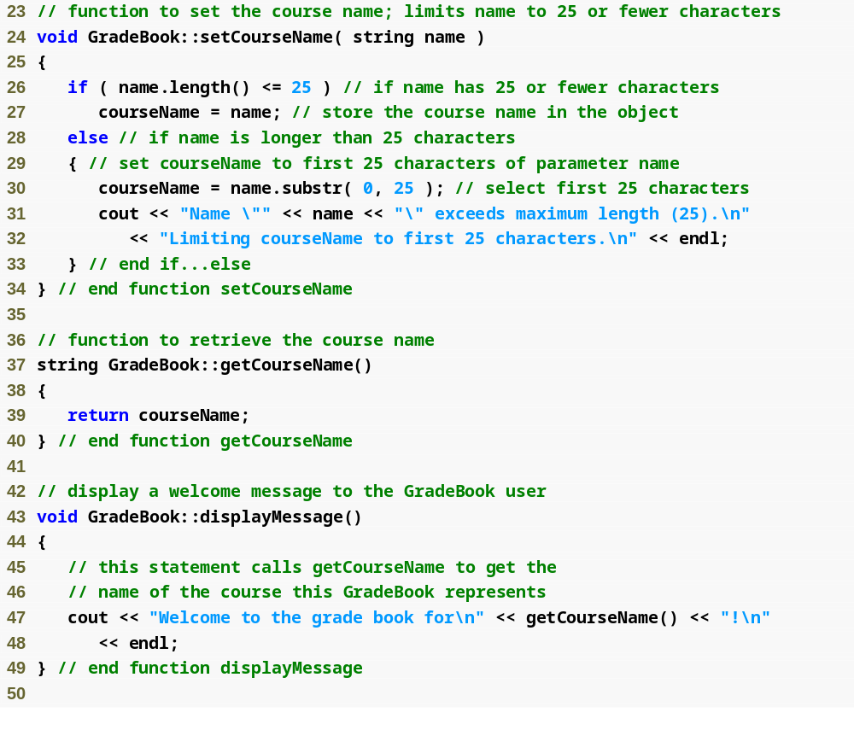
Outline
fig05_10.cpp
(2 of 5)

Slide 28
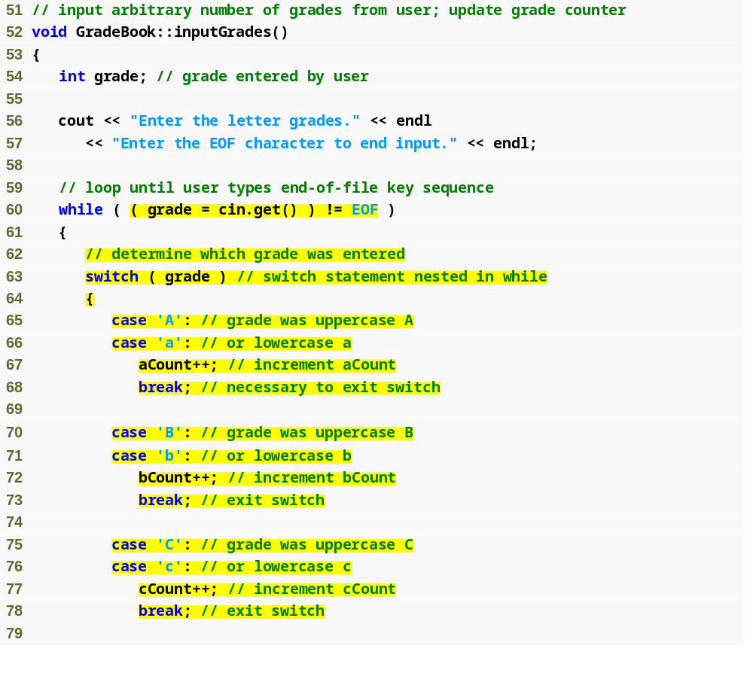
Outline
fig05_10.cpp
(3 of 5)
Loop condition uses function cin.get to determine whether there is more data to input
switch statement determines which case label to execute, depending on controlling expression
grade is the controlling expression
case labels for a grade of A
break statement transfers control to after the end of the switch statement

Slide 29
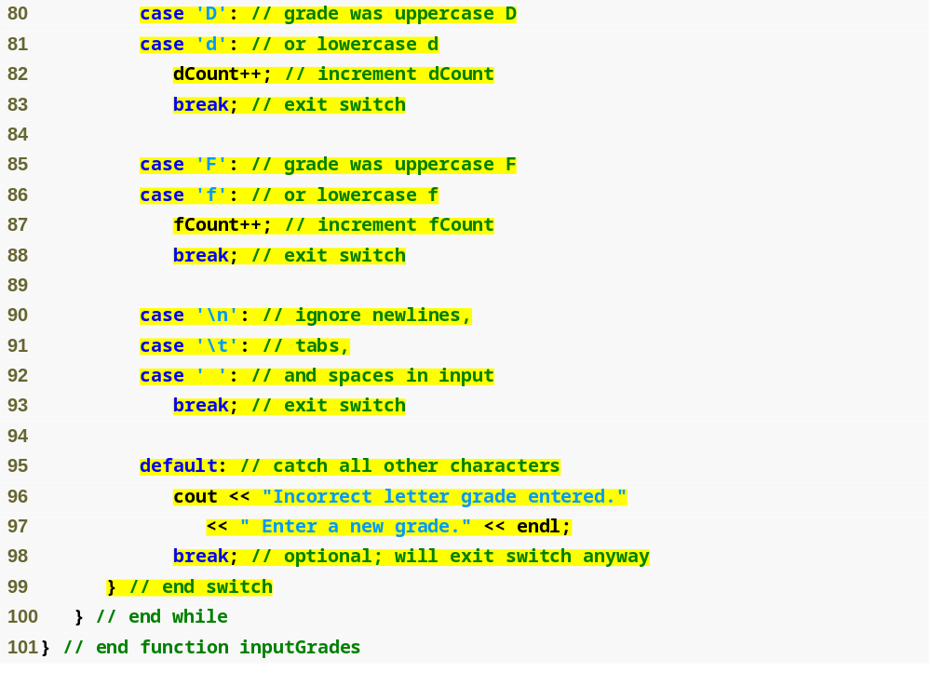
Outline
fig05_10.cpp
(4 of 5)
Ignore whitespace characters, do not display an error message
default case for an invalid letter grade

Slide 30
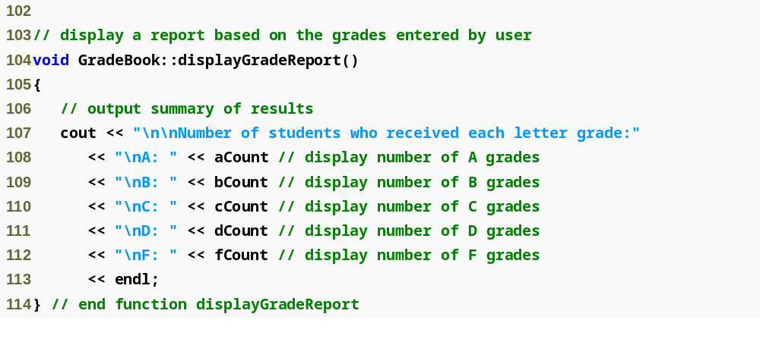
Outline
fig05_01.cpp
(5 of 5)

Slide 31
5.6 switch Multiple-Selection Statement (Cont.)
Reading character input
  Function cin.get()
    Reads one character from the keyboard
  Integer value of a character
    static_cast< int >( character )
  ASCII character set
    Table of characters and their decimal equivalents
  EOF
    <ctrl> d in UNIX/Linux
    <ctrl> z in Windows

Slide 32
5.6 switch Multiple-Selection Statement (Cont.)
switch statement
  Controlling expression
    Expression in parentheses after keyword switch
  case labels
    Compared with the controlling expression
    Statements following the matching case label are executed
      Braces are not necessary around multiple statements in a case label
      A break statements causes execution to proceed with the first statement after the switch
        Without a break statement, execution will fall through to the next case label

Slide 33
5.6 switch Multiple-Selection Statement (Cont.)
switch statement (Cont.)
  default case
    Executes if no matching case label is found
    Is optional
      If no match and no default case
        Control simply continues after the switch

Slide 34
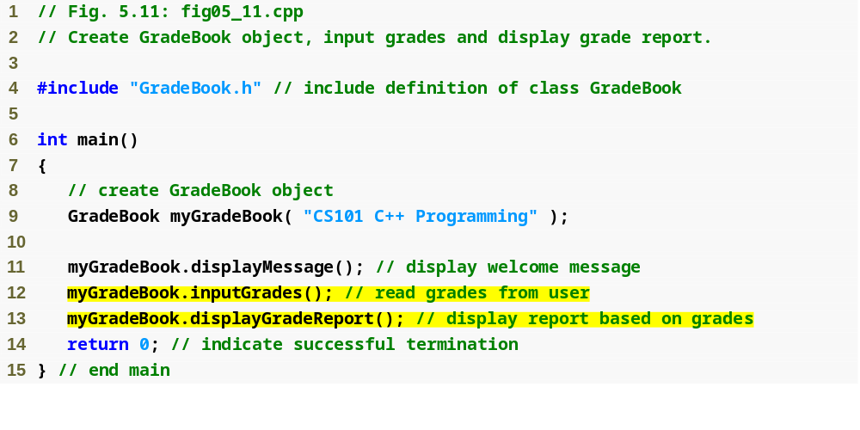
Outline
fig05_11.cpp
(1 of 2)

Slide 35
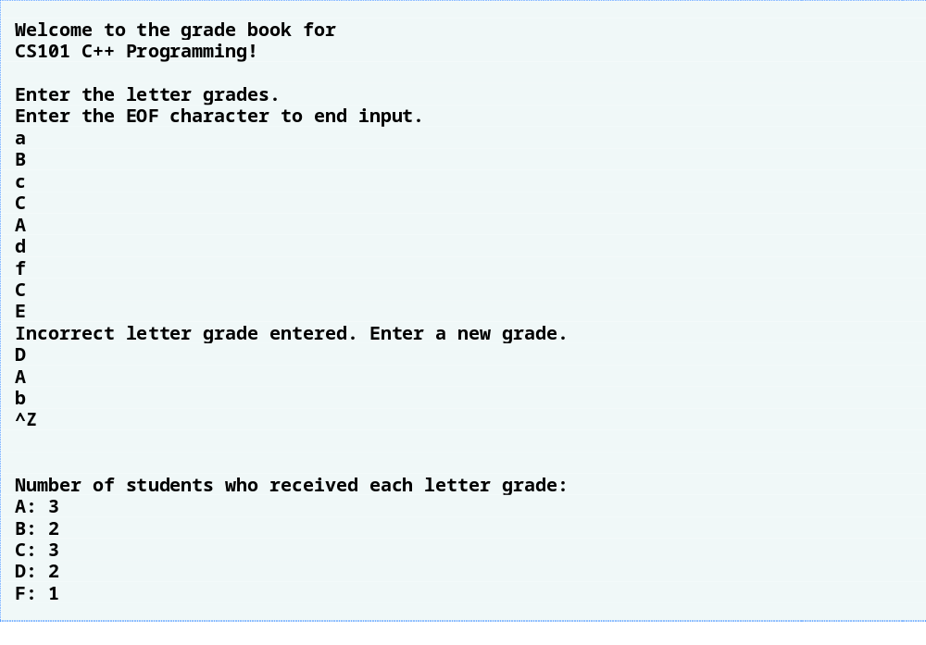
Outline
fig05_11.cpp
(2 of 2)
An error message is shown in response to an invalid grade

Slide 36
5.6 switch Multiple-Selection Statement (Cont.)
Integer data types
  short
    Abbreviation of short int
    Minimum range is -32,768 to 32,767
  long
    Abbreviation of long int
    Minimum range is -2,147,483,648 to 2,147,483,647
  int
    Equivalent to either short or long on most computers
  char
    Can be used to represent small integers

Slide 37
5.7 break and continue Statements
break/continue statements
  Alter flow of control
break statement
  Causes immediate exit from control structure
  Used in while, for, do…while or switch statements
continue statement
  Skips remaining statements in loop body
    Proceeds to increment and condition test in for loops
    Proceeds to condition test in while/do…while loops
  Then performs next iteration (if not terminating)
  Used in while, for or do…while statements

Slide 38
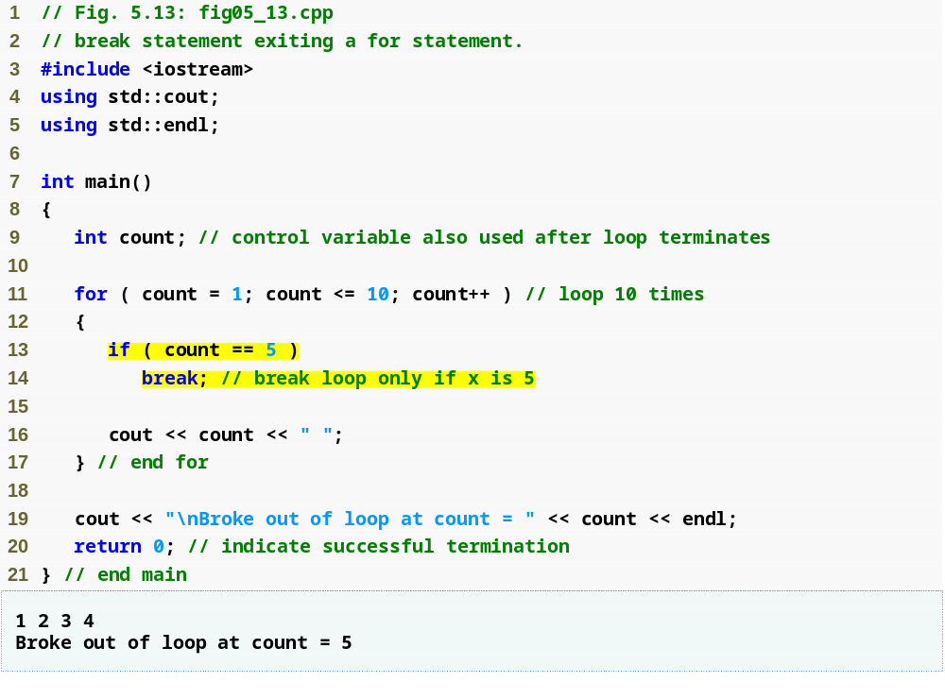
Outline
fig05_13.cpp
(1 of 1)
Loop 10 times
Exit for statement (with a break) when count equals 5

Slide 39
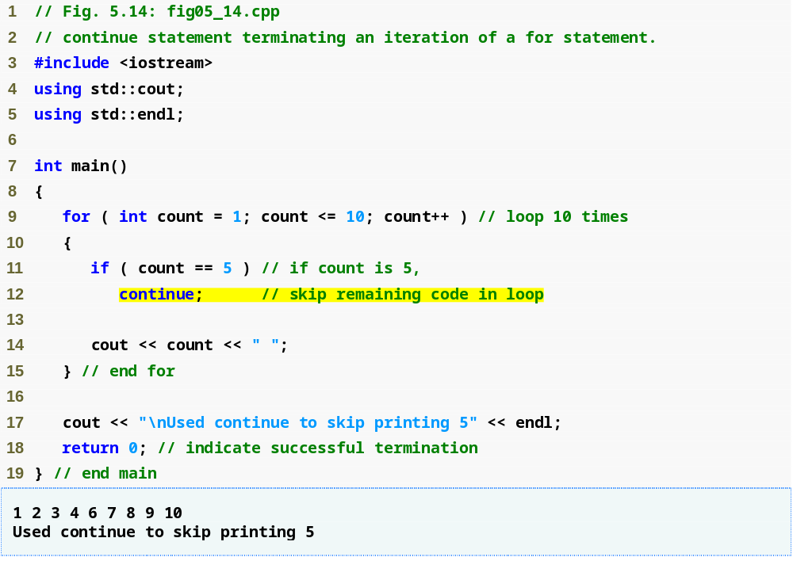
Outline
Loop 10 times
fig05_14.cpp
(1 of 1)
Skip line 14 and proceed to line 9 when count equals 5

Slide 40
5.8 Logical Operators
Logical operators
  Allows for more complex conditions
    Combines simple conditions into complex conditions
C++ logical operators
  && (logical AND)
  || (logical OR)
  ! (logical NOT)

Slide 41
5.8 Logical Operators (Cont.)
Logical AND (&&) Operator
  Consider the following if statement
    if ( gender == 1 && age >= 65 )
    seniorFemales++;
  Combined condition is true
    If and only if both simple conditions are true
  Combined condition is false
    If either or both of the simple conditions are false

Slide 42
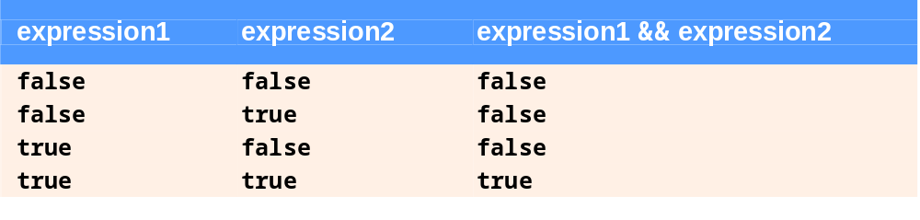
Fig. 5.15 | && (logical AND) operator truth table.

Slide 43
5.8 Logical Operators (Cont.)
Logical OR (||) Operator
  Consider the following if statement
    if ( ( semesterAverage >= 90 ) || ( finalExam >= 90 )
    cout << “Student grade is A” << endl;
  Combined condition is true
    If either or both of the simple conditions are true
  Combined condition is false
    If both of the simple conditions are false

Slide 44
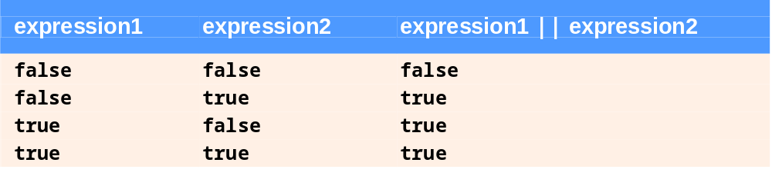
Fig. 5.16 | || (logical OR) operator truth table.

Slide 45
5.8 Logical Operators (Cont.)
Short-Circuit Evaluation of Complex Conditions
  Parts of an expression containing && or || operators are evaluated only until it is known whether the condition is true or false
  Example
    ( gender == 1 ) && ( age >= 65 )
      Stops immediately if gender is not equal to 1
        Since the left-side is false, the entire expression must be false

Slide 46
5.8 Logical Operators (Cont.)
Logical Negation (!) Operator
  Unary operator
  Returns true when its operand is false, and vice versa
  Example
    if ( !( grade == sentinelValue ) )
    cout << "The next grade is " << grade << endl;
    is equivalent to:
    if ( grade != sentinelValue )
    cout << "The next grade is " << grade << endl;
Stream manipulator boolalpha
  Display bool expressions in words, “true” or “false”

Slide 47
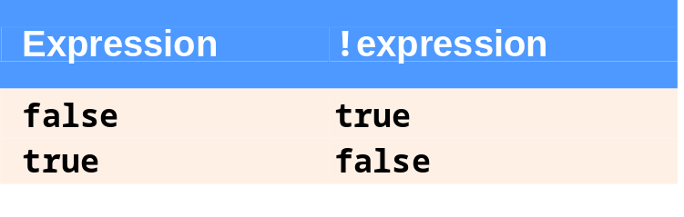
Fig. 5.17 | ! (logical negation) operator truth table.

Slide 48
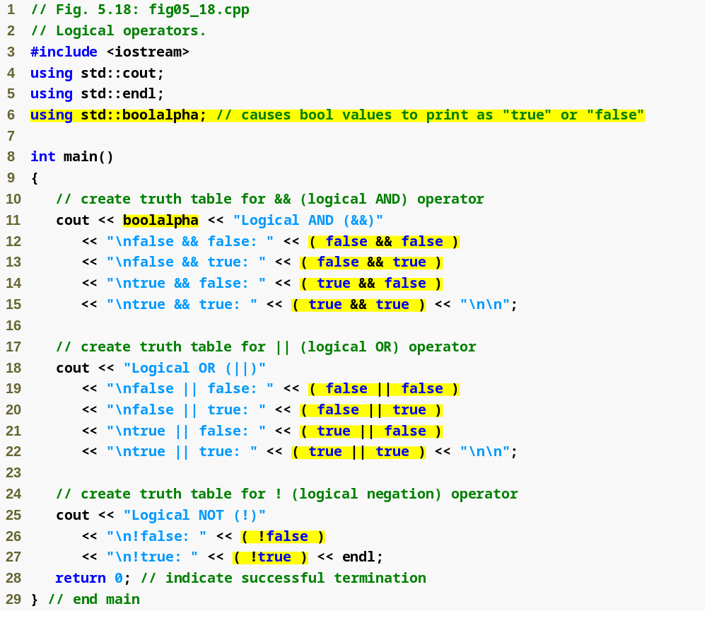
Stream manipulator boolalpha causes bool values to display as the words “true” or “false”
Outline
fig05_18.cpp
(1 of 2)
Use boolalpha stream manipulator in cout
Output logical AND truth table
Output logical OR truth table
Output logical NOT truth table

Slide 49
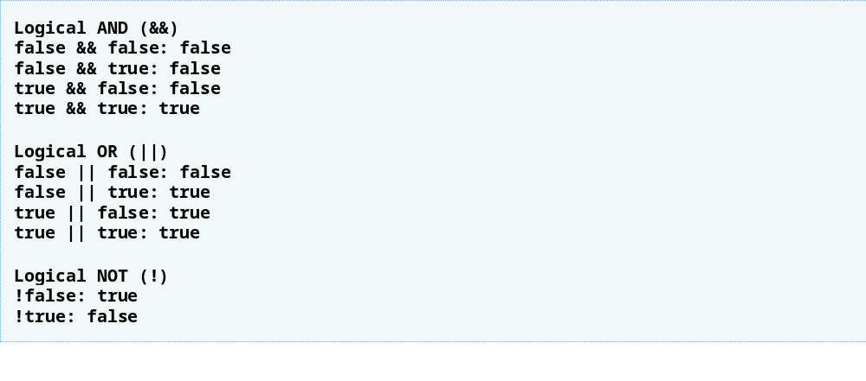
Outline
fig05_18.cpp
(2 of 2)

Slide 50
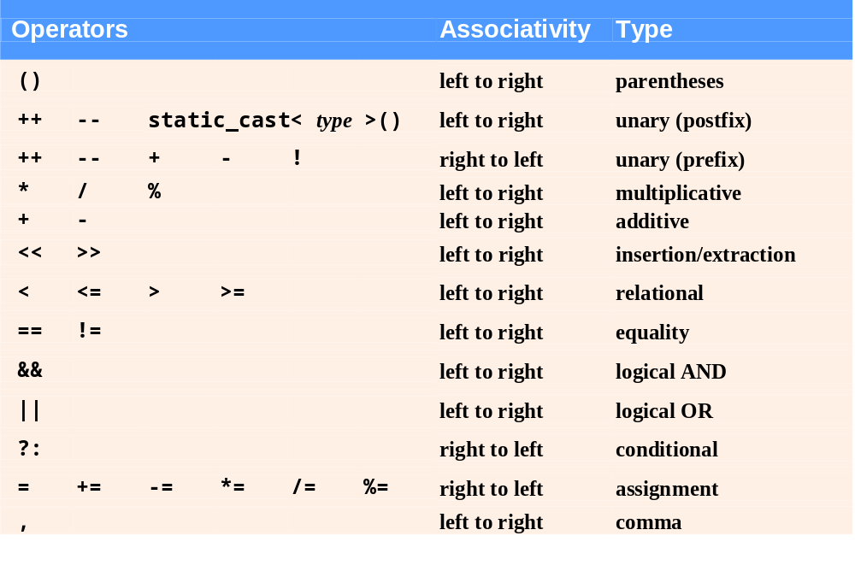
Fig. 5.19 | Operator precedence and associativity.

Slide 51
5.9 Confusing Equality (==) and Assignment (=) Operators
Accidentally swapping the operators == (equality) and = (assignment)
  Common error
    Assignment statements produce a value (the value to be assigned)
    Expressions that have a value can be used for decision
      Zero = false, nonzero = true
  Does not typically cause syntax errors
    Some compilers issue a warning when = is used in a context normally expected for ==

Slide 52
5.9 Confusing Equality (==) and Assignment (=) Operators (Cont.)
Example
    if ( payCode == 4 )
    cout << "You get a bonus!" << endl;
  If paycode is 4, bonus is given
If == was replaced with =
    if ( payCode = 4 )
    cout << "You get a bonus!" << endl;
  paycode is set to 4 (no matter what it was before)
  Condition is true (since 4 is non-zero)
    Bonus given in every case

